Slide 1

Breast Cancer Data Analysis

Slide 2

Using Python

Slide 3


Slide 4
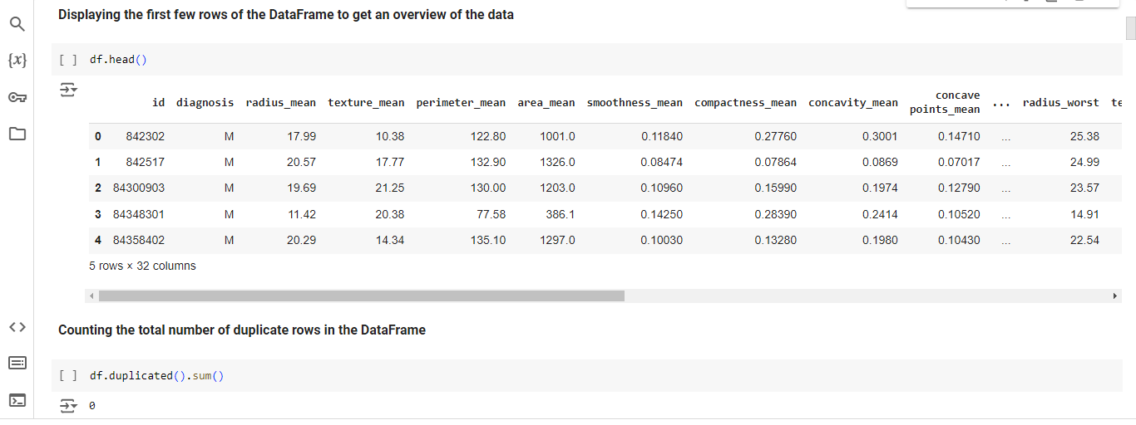

Slide 5
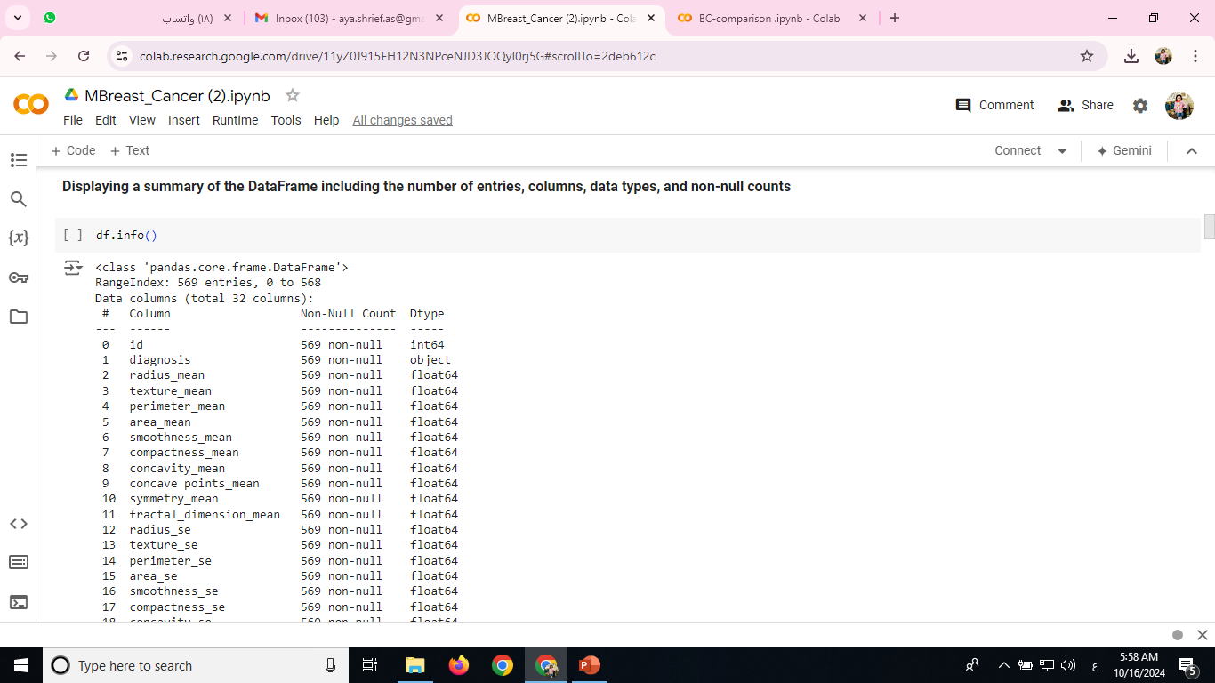
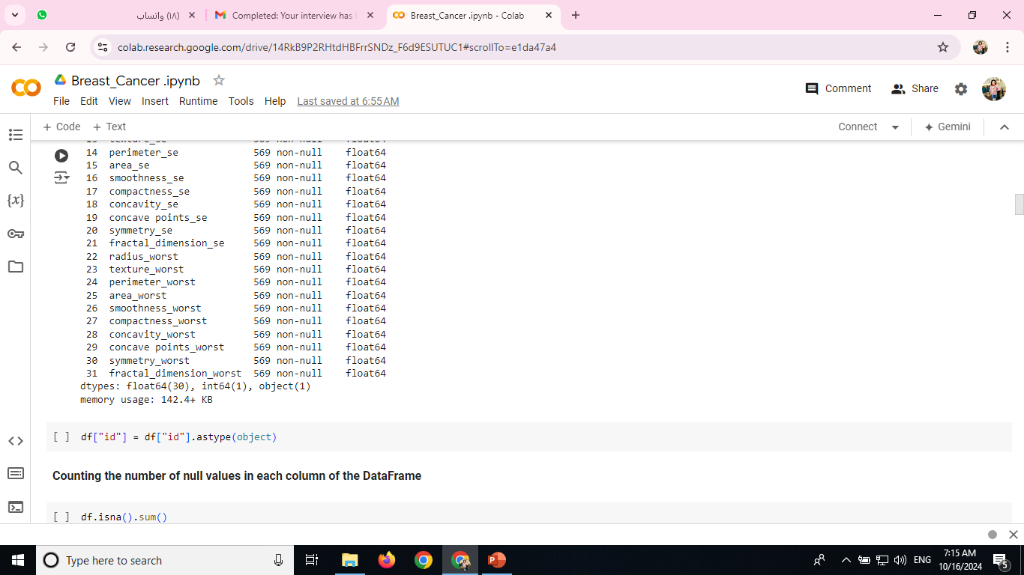

Slide 6




Slide 7
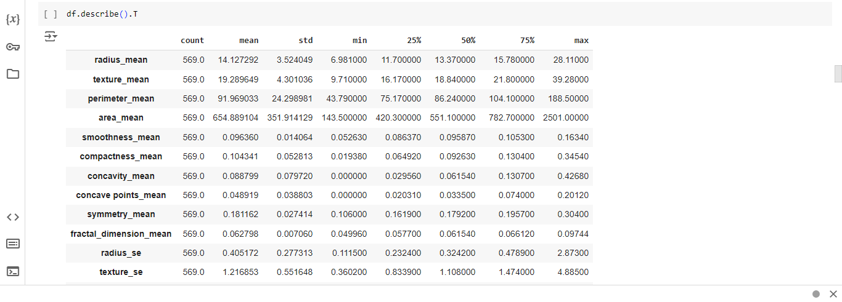

Slide 8


Slide 9
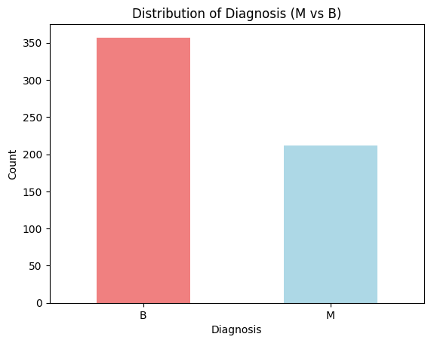
diagnosis_counts = df['diagnosis'].value_counts() print(diagnosis_counts) diagnosis_counts.plot(kind='bar', color=['lightcoral', 'lightblue']) plt.title('Distribution of Diagnosis (M vs B)') plt.xlabel('Diagnosis') plt.ylabel('Count') plt.xticks(rotation=0) plt.show()

Slide 10
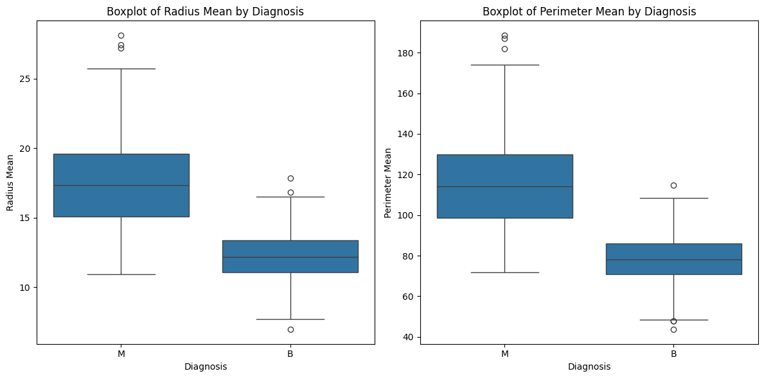
plt.figure(figsize=(12, 6)) plt.subplot(1, 2, 1) sns.boxplot(x='diagnosis', y='radius_mean', data=df) plt.title('Boxplot of Radius Mean by Diagnosis') plt.xlabel('Diagnosis') plt.ylabel('Radius Mean') plt.subplot(1, 2, 2) sns.boxplot(x='diagnosis', y='perimeter_mean', data=df) plt.title('Boxplot of Perimeter Mean by Diagnosis') plt.xlabel('Diagnosis') plt.ylabel('Perimeter Mean') plt.tight_layout() plt.show()

Slide 11
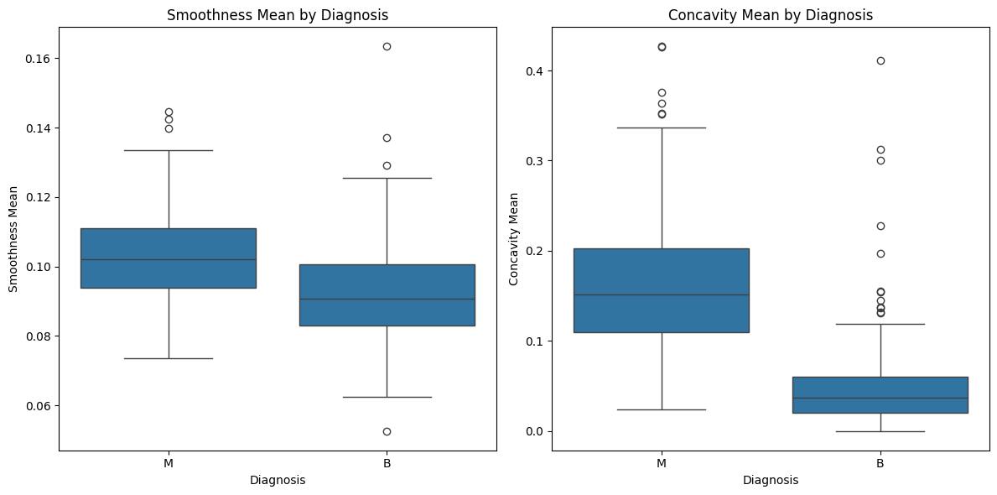
plt.figure(figsize=(12, 6)) plt.subplot(1, 2, 1) sns.boxplot(x='diagnosis', y='smoothness_mean', data=df) plt.title('Smoothness Mean by Diagnosis') plt.xlabel('Diagnosis') plt.ylabel('Smoothness Mean') plt.subplot(1, 2, 2) sns.boxplot(x='diagnosis', y='concavity_mean', data=df) plt.title('Concavity Mean by Diagnosis') plt.xlabel('Diagnosis') plt.ylabel('Concavity Mean') plt.tight_layout() plt.show()

Slide 12
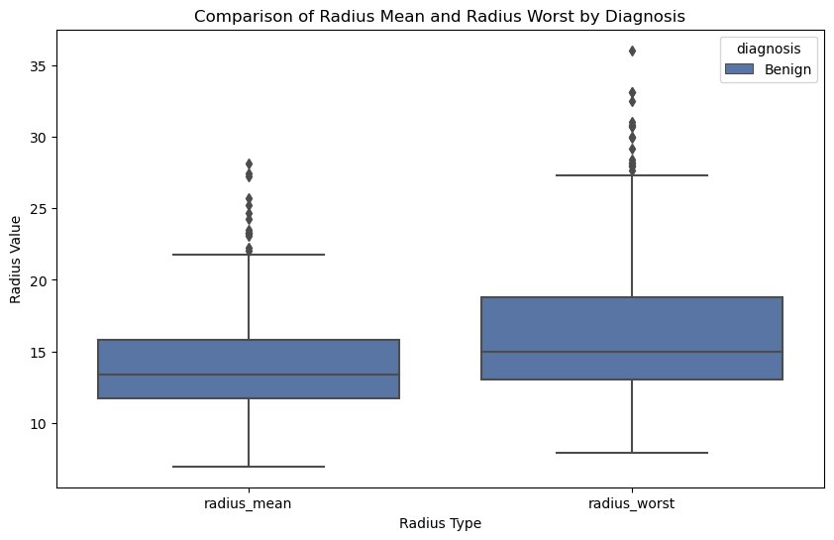
# Encode the diagnosis (M -> 1, B -> 0) for easier plotting
df['diagnosis'] = df['diagnosis'].apply(lambda x: 'Malignant' if x == 'M' else 'Benign')
# Create a new DataFrame with only relevant columns
radius_data = df[['diagnosis', 'radius_mean', 'radius_worst']]
# Melt the DataFrame to have 'radius_mean' and 'radius_worst' in a single column for plotting
radius_melted = radius_data.melt(id_vars='diagnosis', var_name='Radius Type', value_name='Value')
# Plot the boxplot
plt.figure(figsize=(10, 6))
sns.boxplot(x='Radius Type', y='Value', hue='diagnosis', data=radius_melted, palette='deep')
plt.title('Comparison of Radius Mean and Radius Worst by Diagnosis')
plt.ylabel('Radius Value')
plt.show()

Slide 13
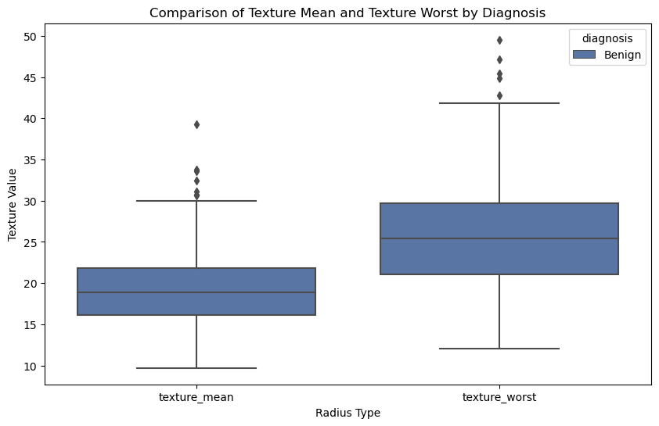
# Encode the diagnosis (M -> 1, B -> 0) for easier plotting
df['diagnosis'] = df['diagnosis'].apply(lambda x: 'Malignant' if x == 'M' else 'Benign')
# Create a new DataFrame with only relevant columns
radius_data = df[['diagnosis', 'texture_mean', 'texture_worst']]
# Melt the DataFrame to have 'radius_mean' and 'radius_worst' in a single column for plotting
radius_melted = radius_data.melt(id_vars='diagnosis', var_name='Radius Type', value_name='Value')
# Plot the boxplot
plt.figure(figsize=(10, 6))
sns.boxplot(x='Radius Type', y='Value', hue='diagnosis', data=radius_melted, palette='deep')
plt.title('Comparison of Texture Mean and Texture Worst by Diagnosis')
plt.ylabel('Texture Value')
plt.show()

Slide 14
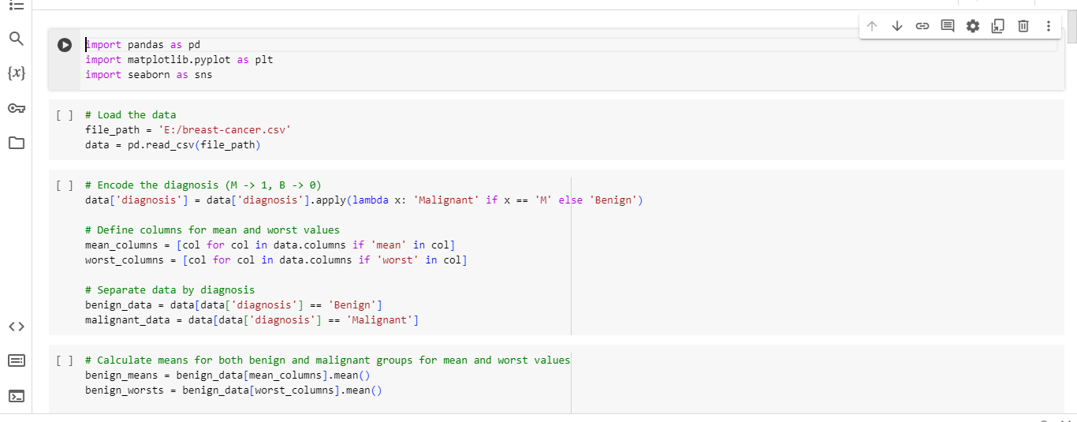

Slide 15
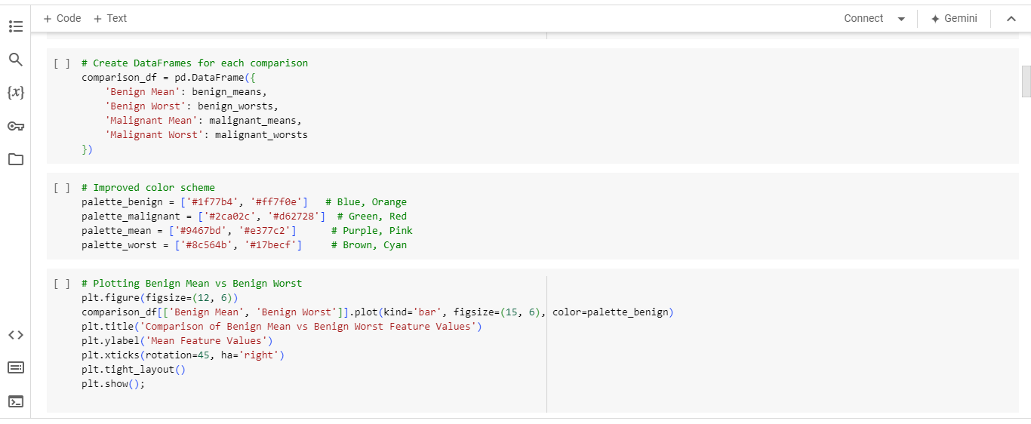

Slide 16
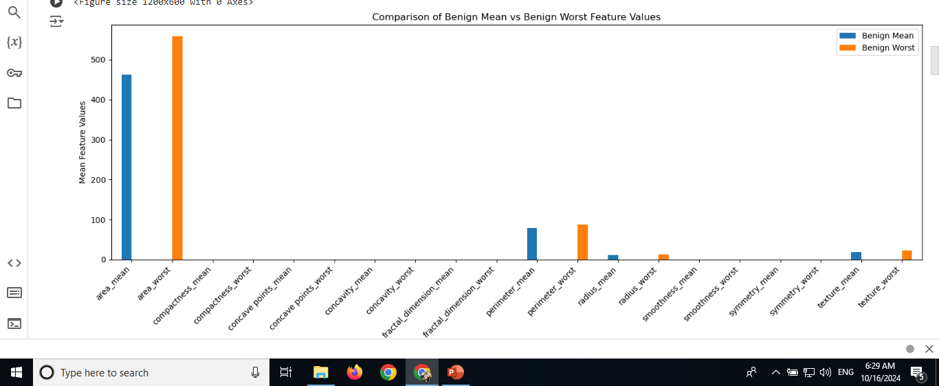

Slide 17
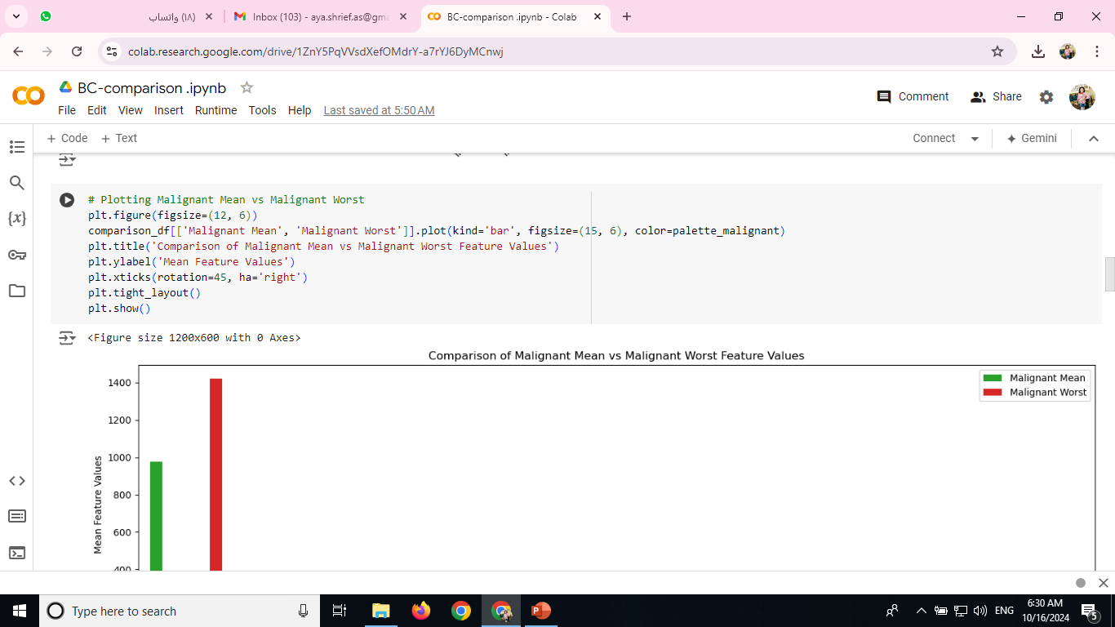
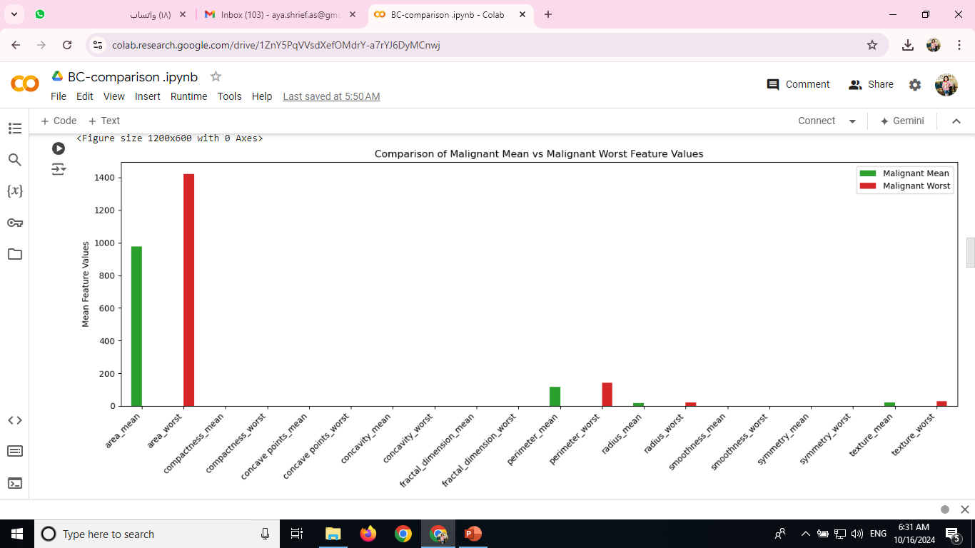

Slide 18
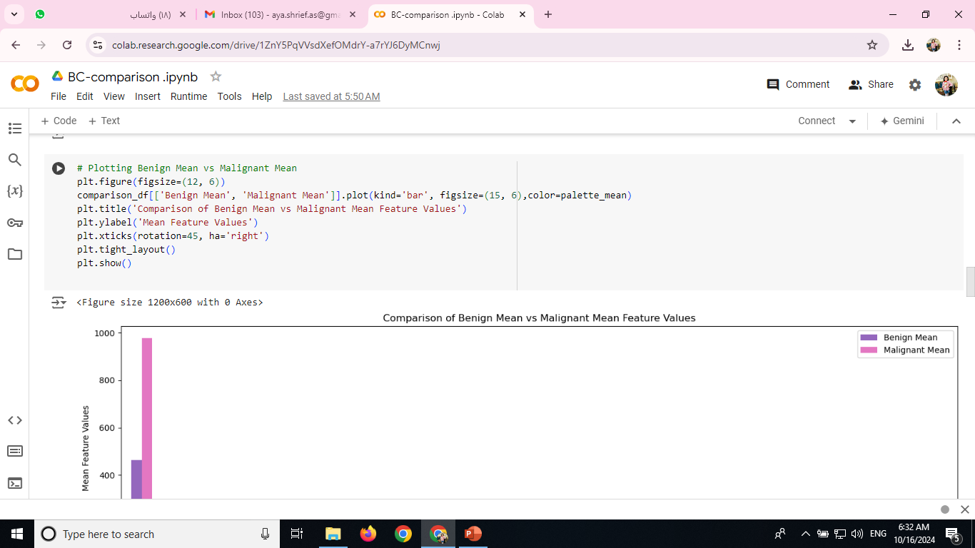
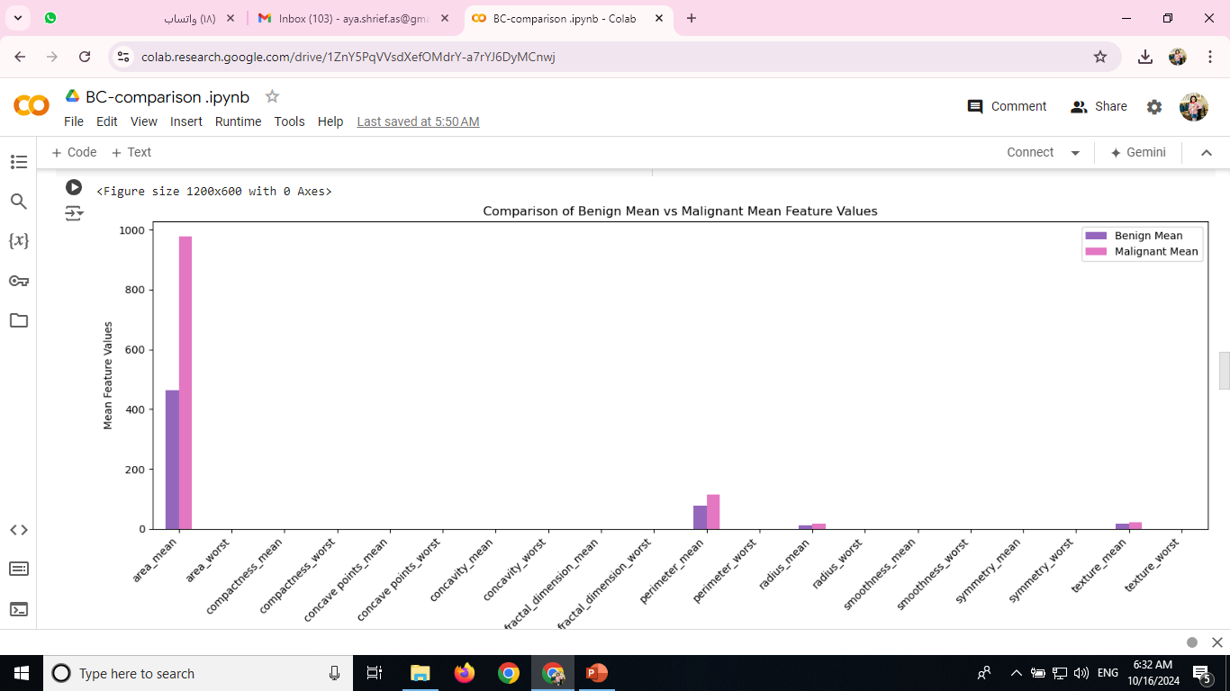

Slide 19
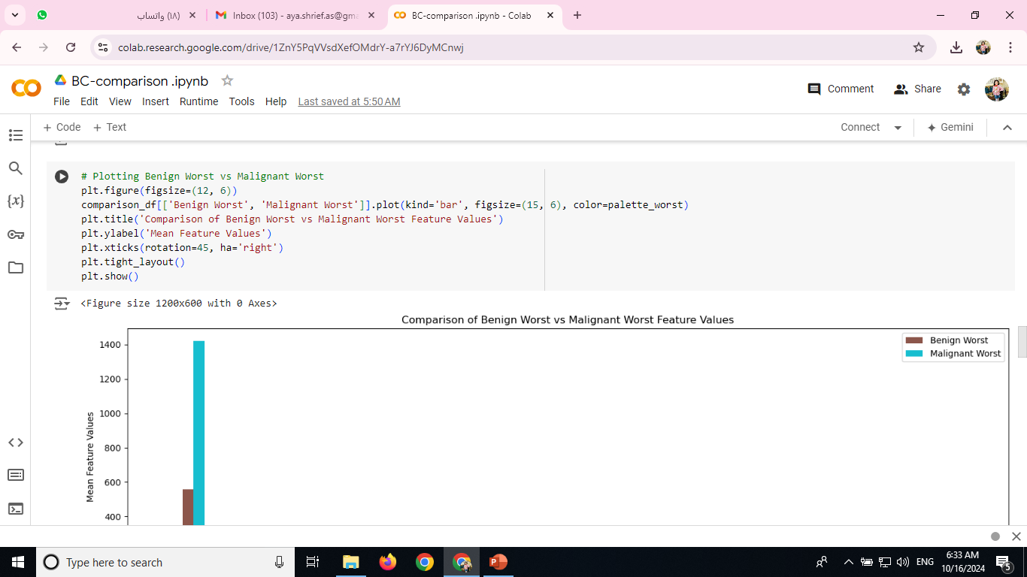
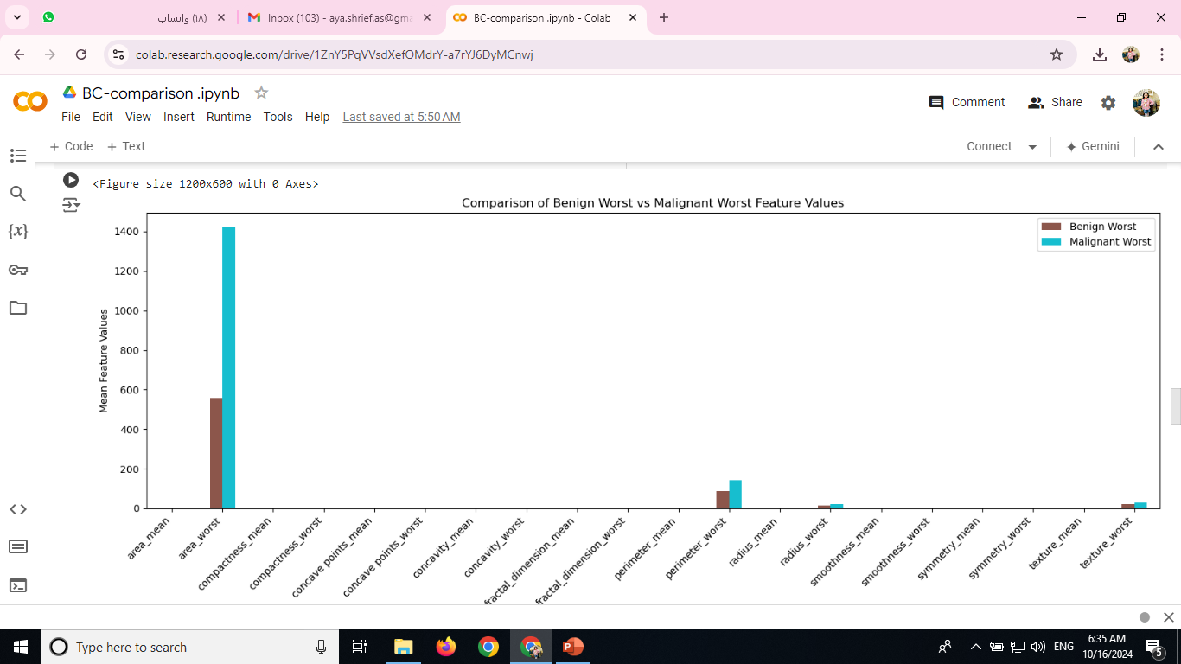

Slide 20
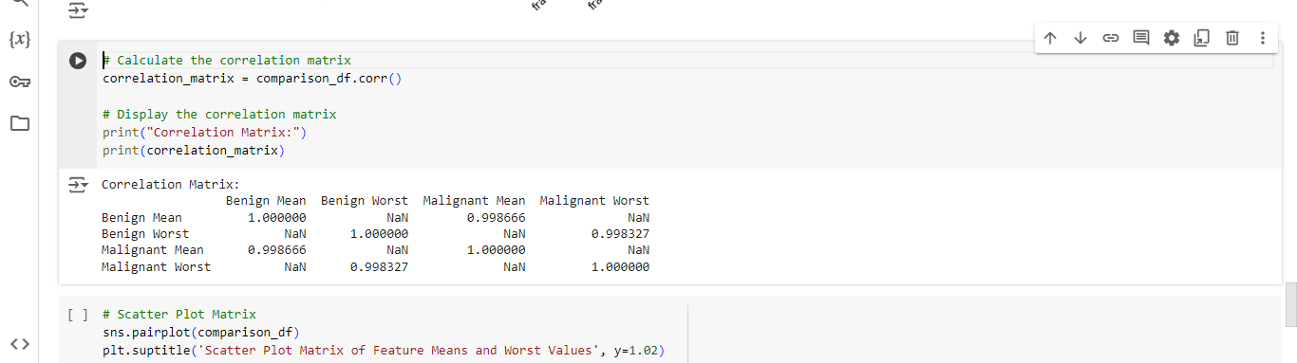

Slide 21
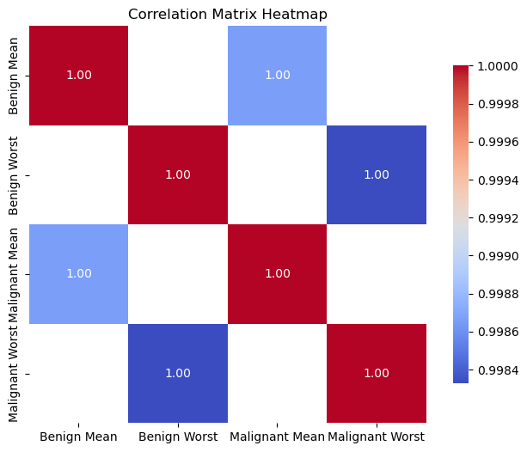
# Plotting the correlation heatmap
plt.figure(figsize=(8, 6))
sns.heatmap(correlation_matrix, annot=True, fmt=".2f", cmap='coolwarm', square=True, cbar_kws={"shrink": .8})
plt.title('Correlation Matrix Heatmap')
plt.show()

Slide 22
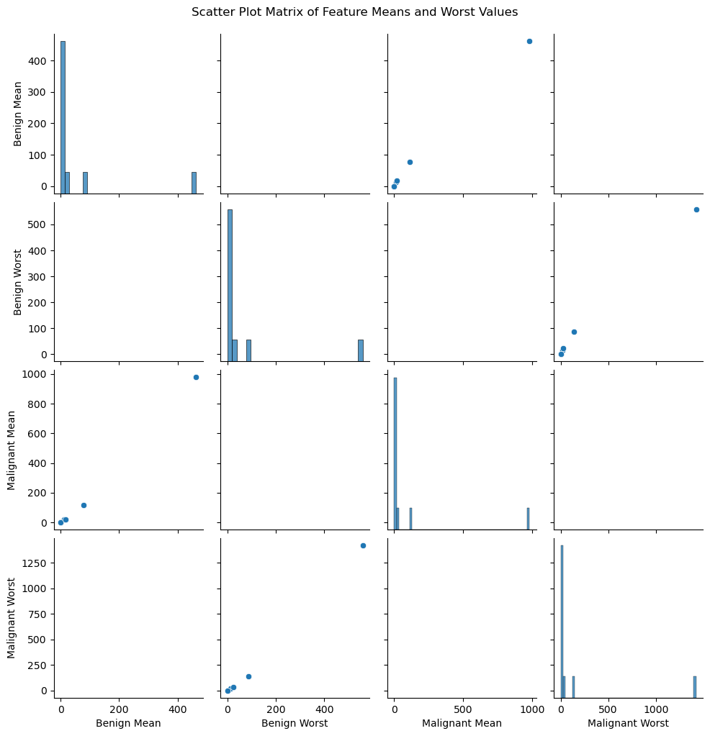
# Scatter Plot Matrix sns.pairplot(comparison_df) plt.suptitle('Scatter Plot Matrix of Feature Means and Worst Values', y=1.02) plt.show()

Slide 23
Using SQL

Slide 24
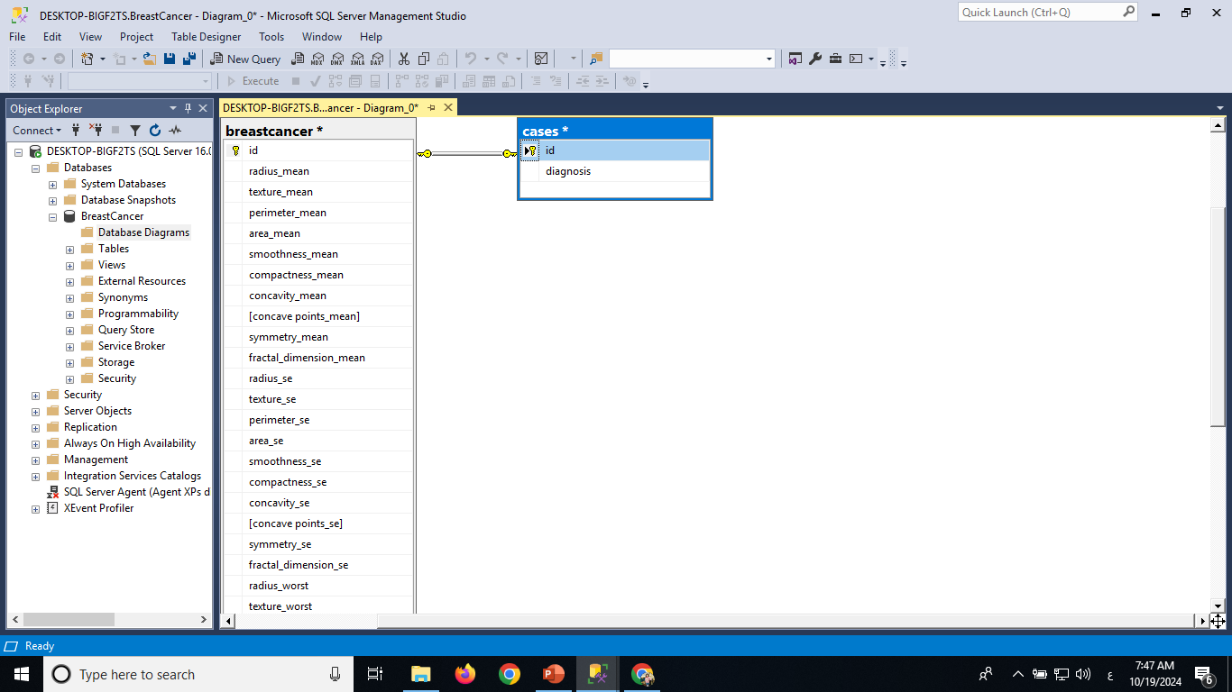

Slide 25
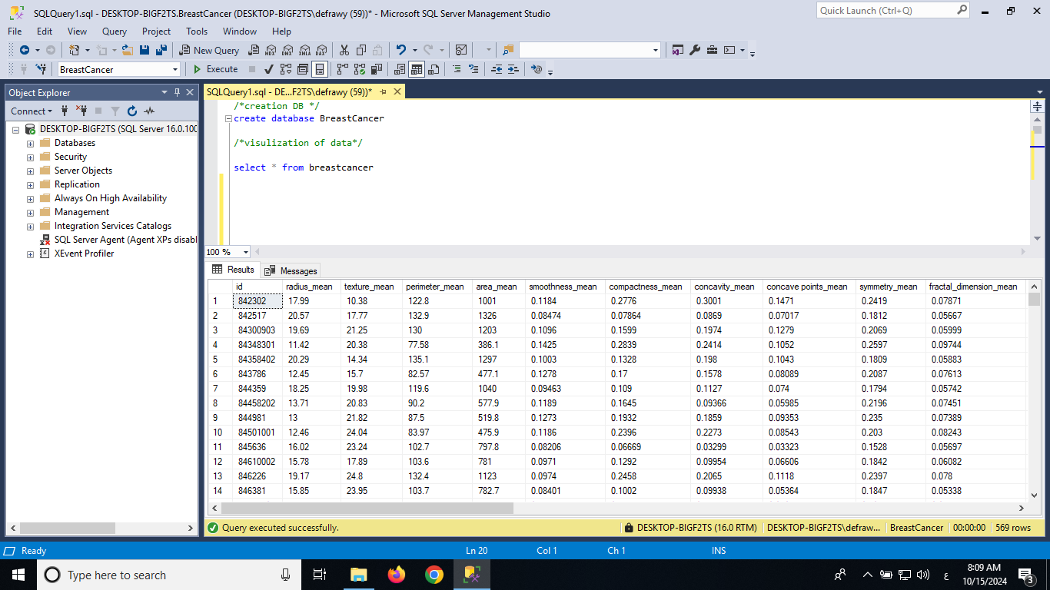


Slide 26
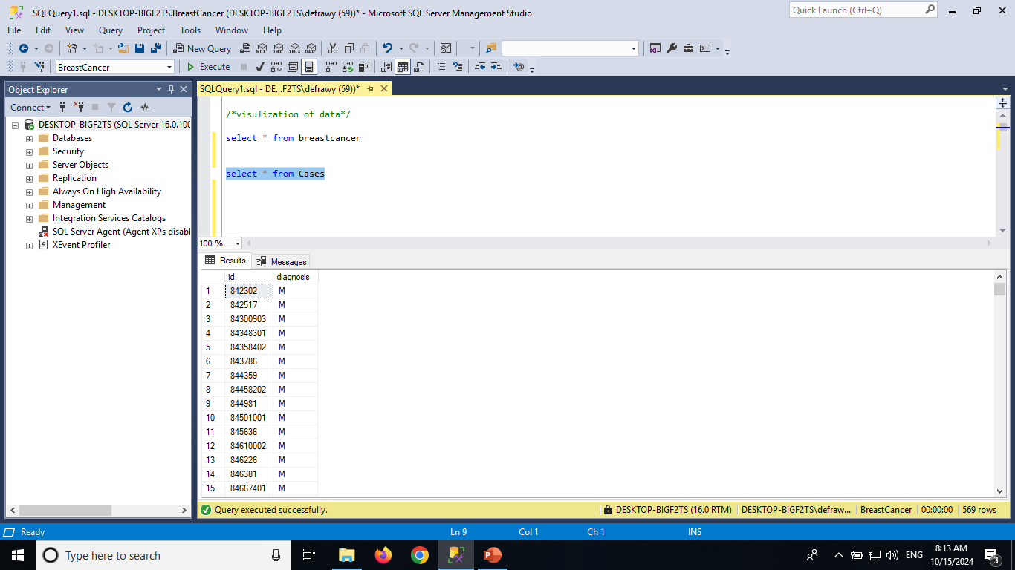

Slide 27
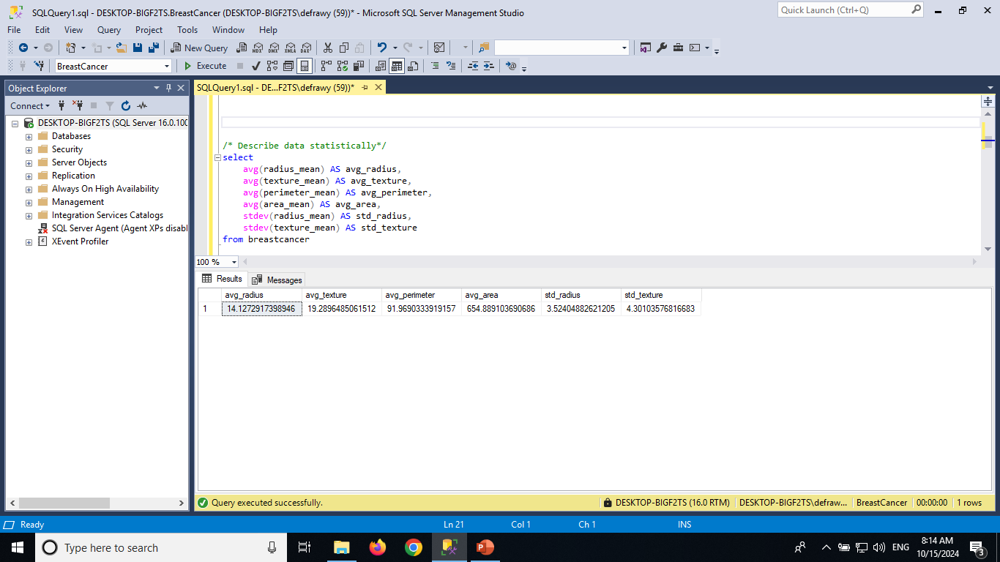

Slide 28
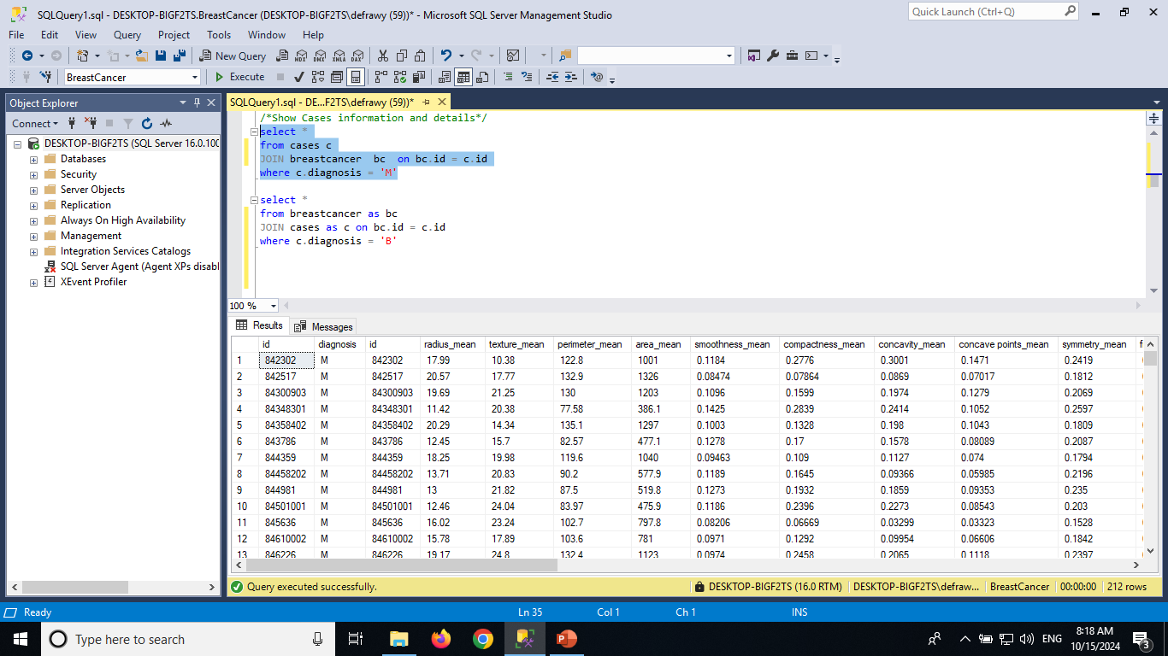

Slide 29
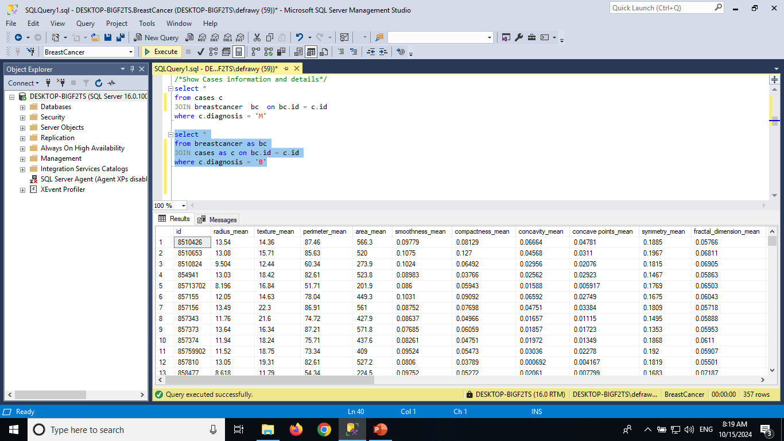

Slide 30

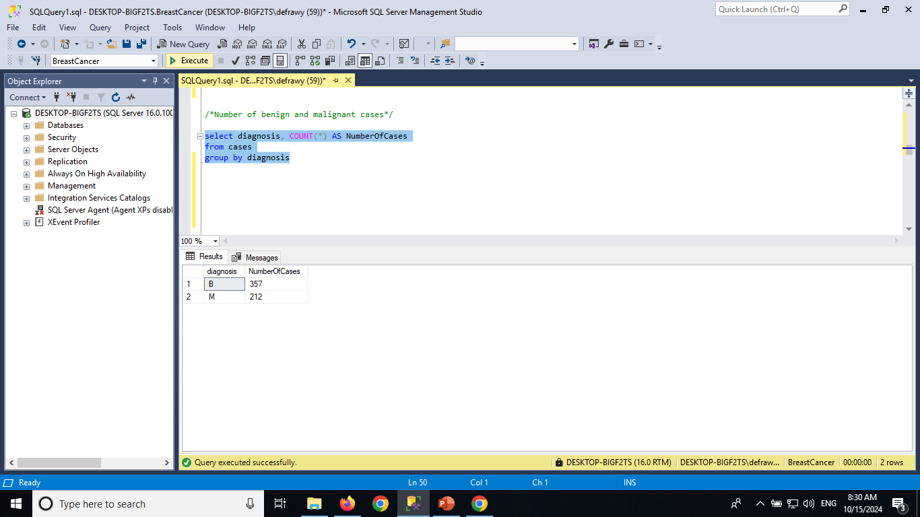

Slide 31
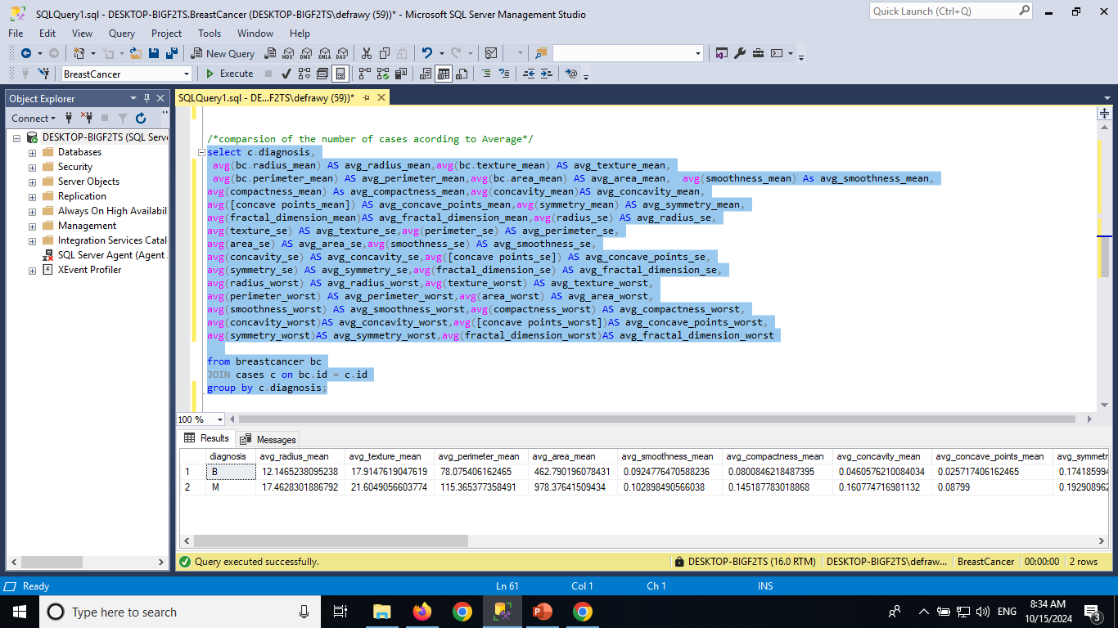

Slide 32
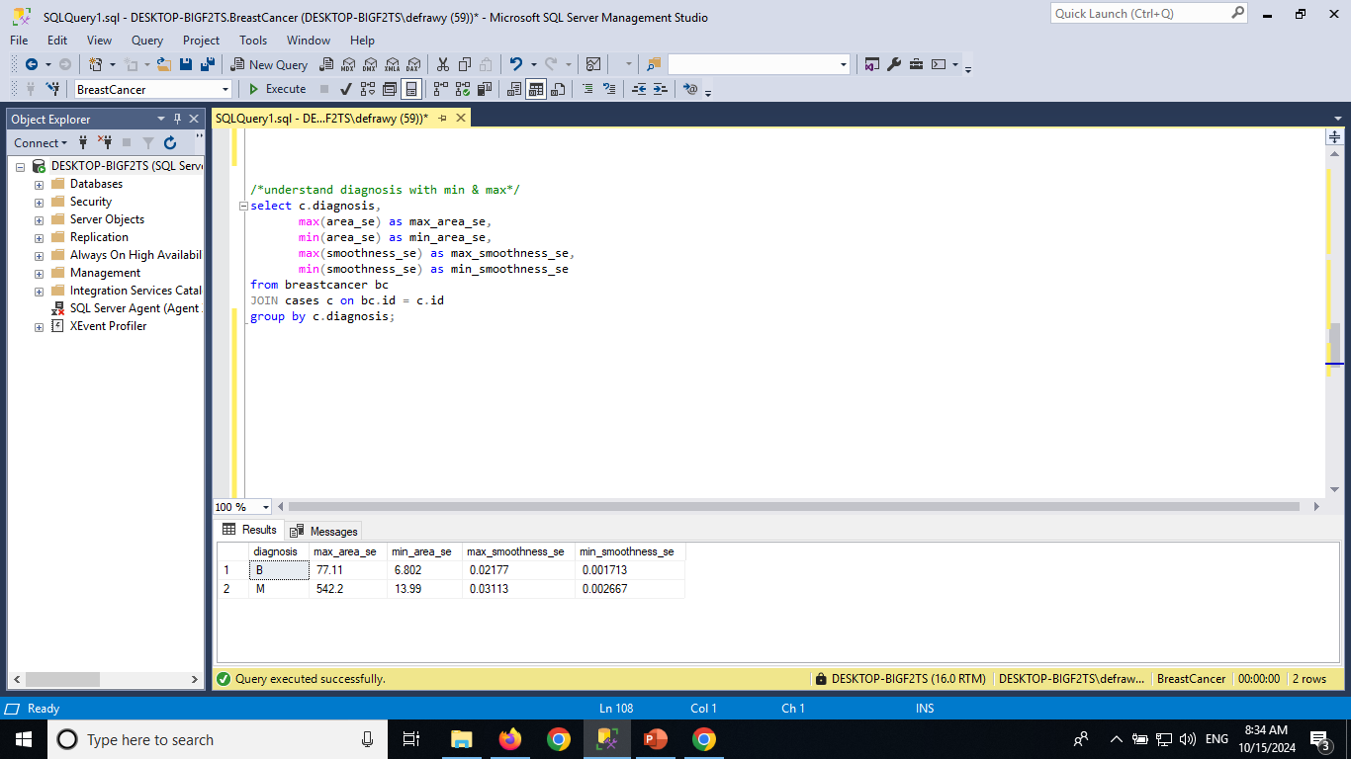

Slide 33
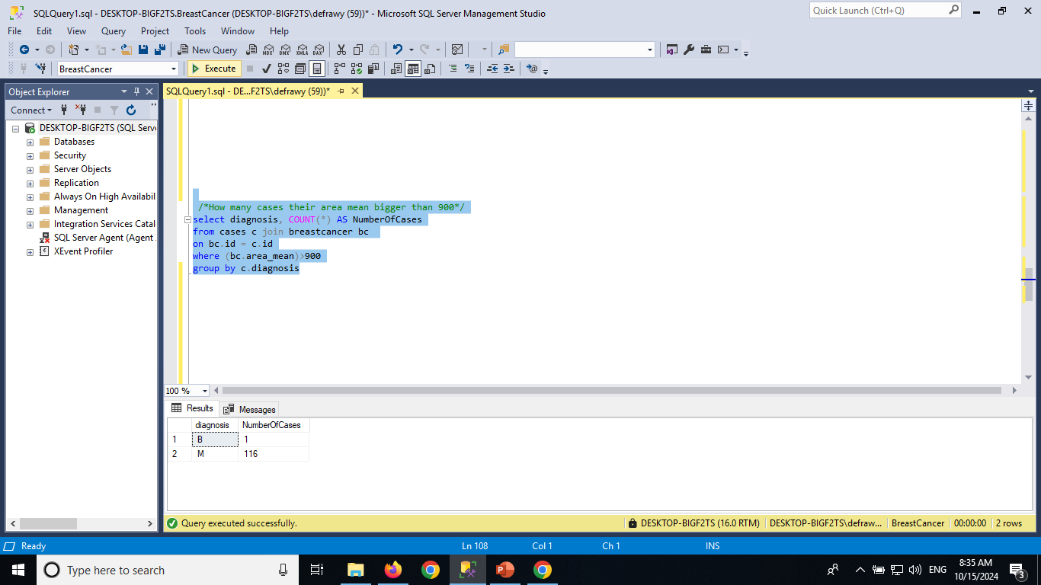

Slide 34
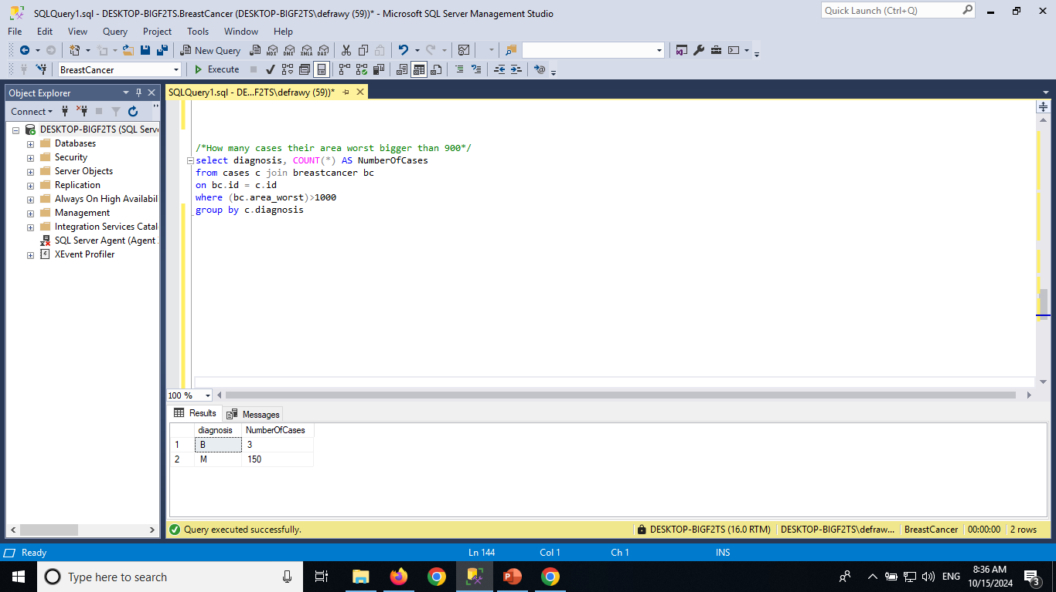

Slide 35
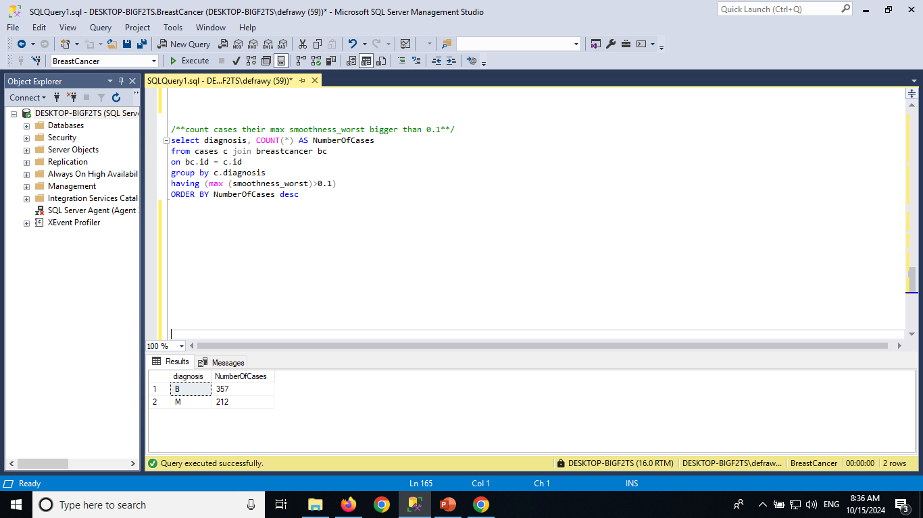

Slide 36
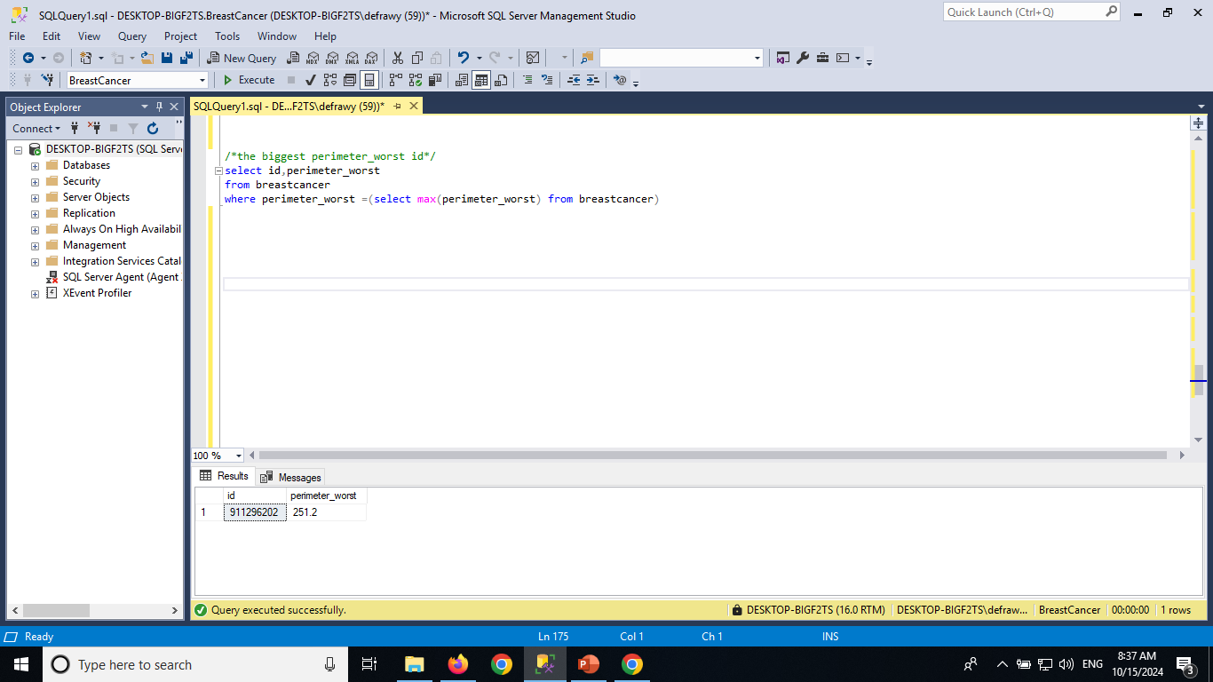

Slide 37
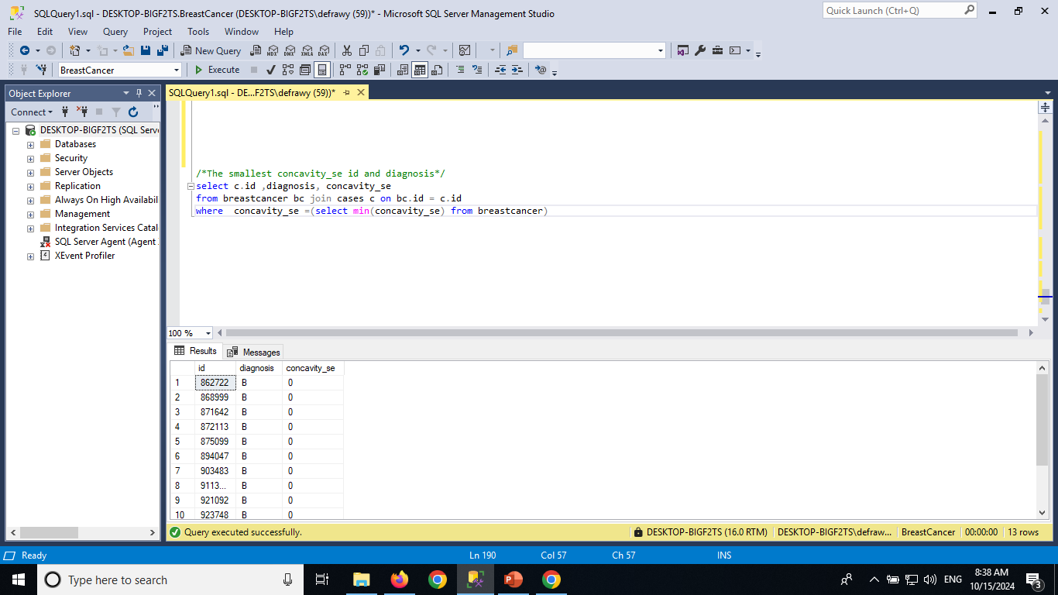

Slide 38
Dashboard

Slide 39
